Slide 1
Darwin Kendo Club
Movie Night – Saturday 2 October 2021
Yojimbo 用心棒 (1961)
Director: Akira Kurosawa
Bernard Yehuda

Slide 2
Housekeeping
Thank you for coming, whether you are a Kendo practitioner, family or friend, or as a guest – I hope you enjoy the night.
This is not a formal event – feel free to relax, ask questions, laugh, and make fun of each other (especially Angus).
Front door is locked – if you need to exit, please use the side door by the barbecue. Call me (Bernard) if needed – 0430 398 358.
If you need to go to the bathroom, please raise your hands, and keep them up until you return.

Slide 3
Agenda
The Romanticisation of the Bushidō
Influence of the Bushidō… (or at least, the cool parts of it)
Let’s Watch: Yojimbo (1961)!

Slide 4
1. The Romanticisation of the Bushidō

Slide 5
1. The Romanticisation of the Bushidō
武士道
What does “bushido” mean?
“The Way of the Warrior”?

Slide 6
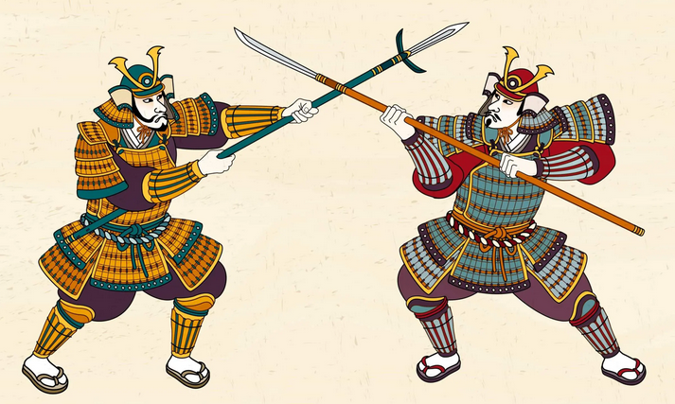
1. The Romanticisation of the Bushidō
武
martial
English definition: relating to fighting or war
From the Latin martialis: of or pertaining to Mars, the Roman God of War.
In Japanese, originally meant “to stop the fight”.
bu
+
戈
止
two blades crossing (e.g. spears)
stop

Slide 7
1. The Romanticisation of the Bushidō
士
warrior
English definition: a brave or experienced soldier or fighter
In Japanese / Chinese, colloquially used in conjunction with another kanji / word, referring to a person with a certain qualification.
shi
弁護士
会計士
護士
bengoshi
Lawyer
kaikeshi
Accountant
hùshì
Nurse

Slide 8
1. The Romanticisation of the Bushidō
道
road / way / path
Literally means a road (as in, pavement, street). When attached to names or object, it means “the road to <that place>”.
The same as the dō in:
Kendō – the way of the sword
Aikidō – the way of the spiritual harmony
Karate-dō – the way of the empty fist
Judō – the way of the soft
Taekwondo – the way of kick and punch
Jeet Kune dō – the way of the intercepting fist
dō / michi

Slide 9
1. The Romanticisation of the Bushidō
道
The use of dō to mean “the way of doing X” is a relatively modern invention.
During the Meiji Restoration Era in the 19th century, Japan went through a period of swift modernisation where martial arts (i.e. techniques to kill people) were banned.
Many arts transformed from jutsu (techniques) to dō (way of), in an attempt to distance themselves away from the violent nature of the war arts, and realign towards something that is healthy, and focused on mental prowess as much as (if not more than) physical.
Kenjutsu → Kendō
Aikijutsu → Aikidō
Jujutsu → Judō
dō / michi
術
There is then a separation between:
武術 bujutsu and 武道 budō
Referring to “pre-war” and “post-war” (modern).
jutsu

Slide 10
Haga-ha Kendo: Pre-WWII Kendo Training Footage
https://www.youtube.com/watch?v=uVnK1Sw7HuI

Slide 11
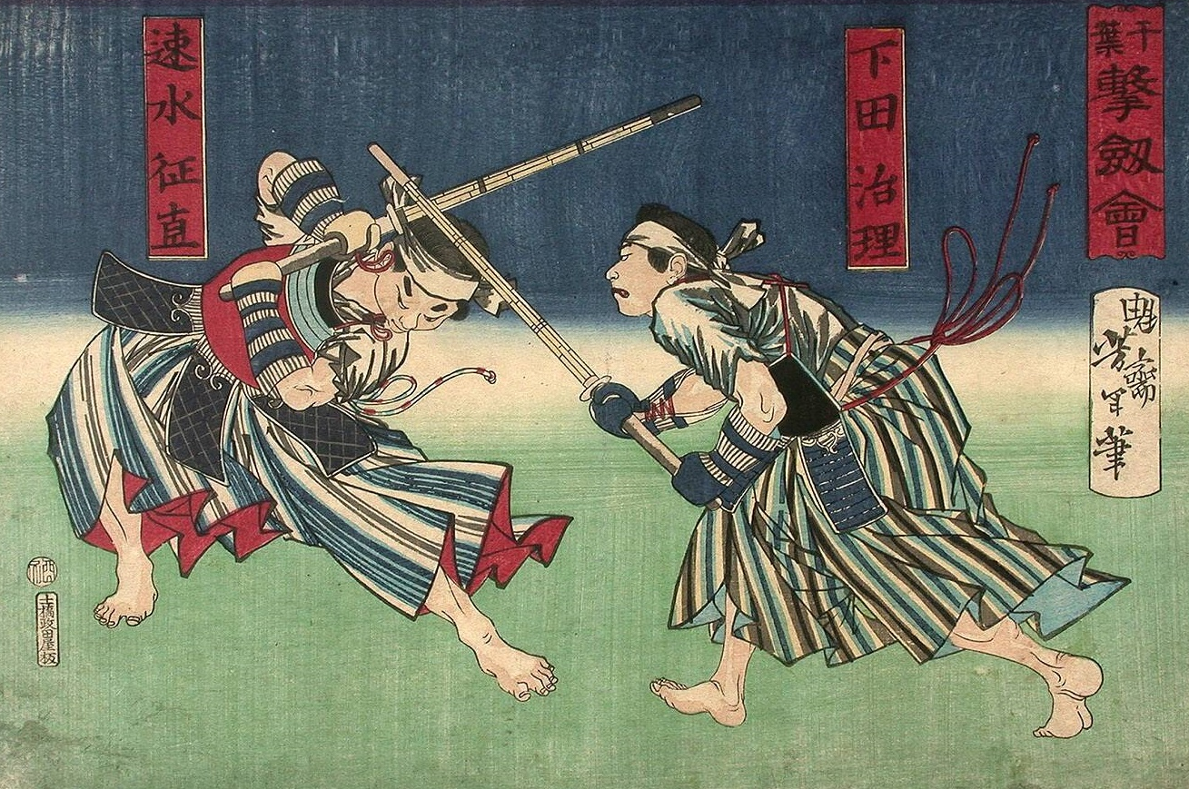
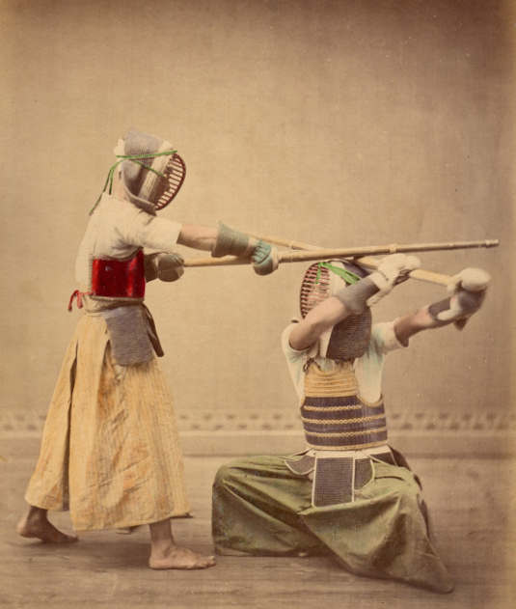
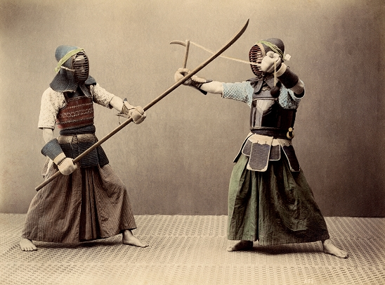
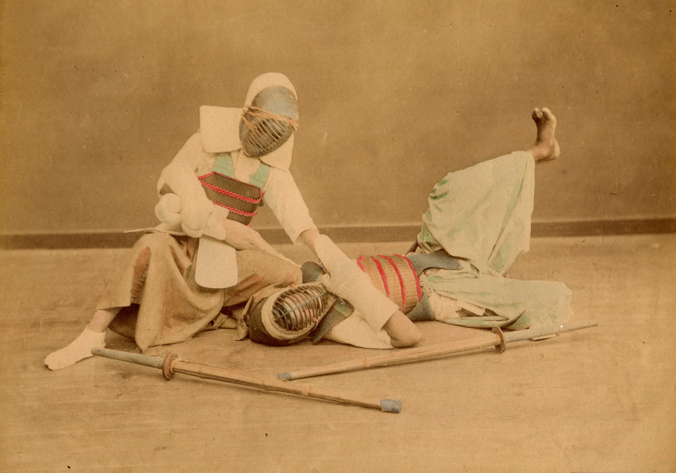
1. The Romanticisation of the Bushidō
Before the war, “Kendō” wasn’t a thing. While Kenjutsu practitioners were wearing bōgu and trained with shinai, there were no overarching rules or training methods.
Different schools were practising their own techniques; they just happened to be using the same equipment.
As the techniques were made for real fighting, many of them included grappling or other weapons.

Slide 12
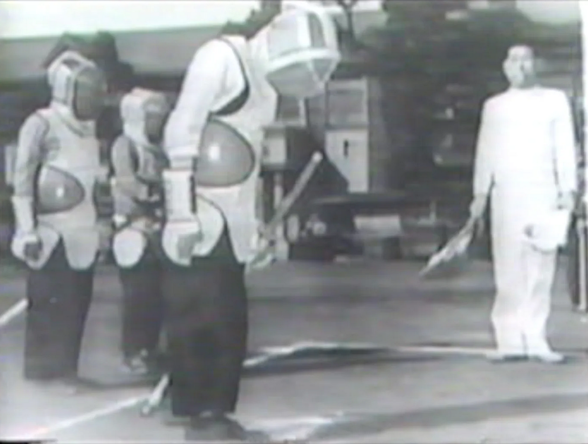
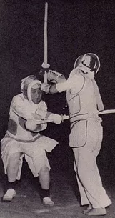
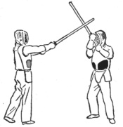
1. The Romanticisation of the Bushidō
Thankfully, Kenjutsu went through a similar evolution. However, its journey to become Kendō was not smooth!
It’s very hard to argue “learning how to use swords is not violent at all”. A lot of effort was made to distance Kendō from its violent history.
The original kanji for shinai 竹刀 (bamboo and sword) was replaced with the hiragana spelling しない; which itself came from the Japanese word for “bend” or “flex” 撓う shinau.
Shinai-kyogi was a sport invented to bridge the gap – introducing a uniform similar to Karate, with padded armour and helmet similar to European Fencing. This sport also introduced sports-like rules and regulations – standardised equipment, court size, three referees, scoring system, etc.
Some terms were replaced, e.g. nafuda (name tag) with zekken, which came from the German word for “name label”.

Slide 13
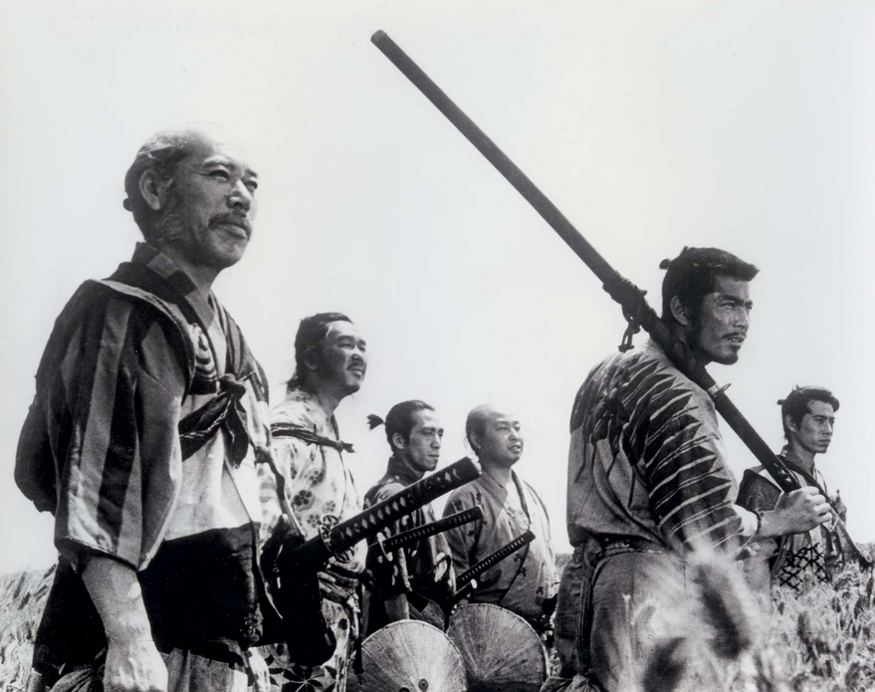
1. The Romanticisation of the Bushidō
武道
These new arts, modernised to focus on the positive aspects of what were originally killing techniques – are now called budō – “the martial way”.
The dō refers to a lifelong journey of bettering oneself and the society through the practice of a particular art.
Gichin Funakoshi, founder of Shotokan Karate, once said:
“ We take different roads to ascend the mountain. ”
This refers to a philosophical belief in Taoism and Buddhism, where our goal in life is to seek enlightenment. However, there is no one correct way to do this – we all can reach the top through many means. Be it through martial arts, sports, career, or family – each individual defines their own criteria of success.
The life of a humble farmer is no less than the life of a Samurai.
This philosophy is reflected in many movie tropes where the good guy fights to protect the weak from their oppressors.
budō
Seven Samurai (1954)

Slide 14
2. Influence of the Bushidō… (or at least, the cool parts of it)

Slide 15
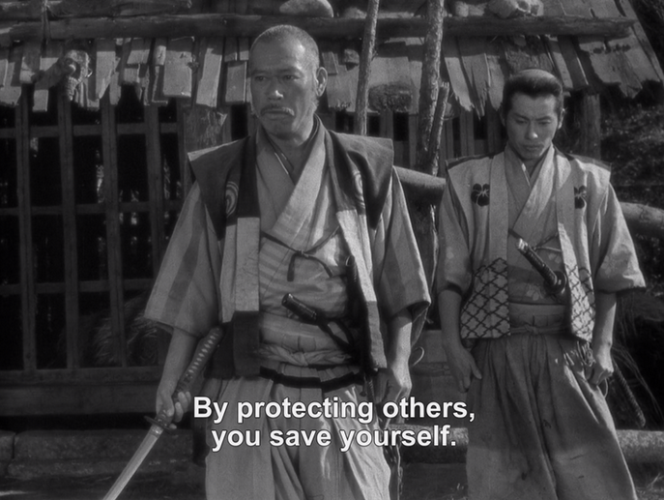
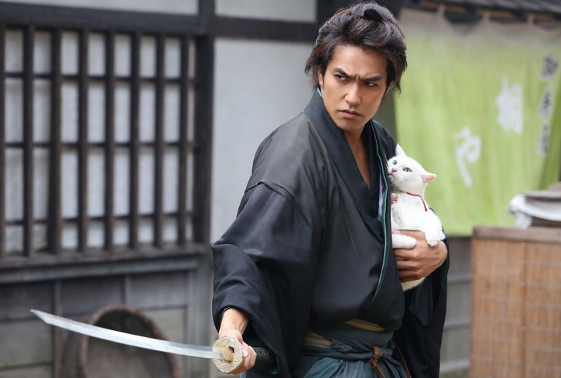
2. Influence of the Bushidō
By design, we have now been conditioned to think that:
Jutsu (technique) was the old bad stuff. Too violent!
Dō (the art of, way of) is new, cool, and totally good for kids.
Therefore, bushidō is a modern term that only looks at the positive aspects of martial arts and warfare, removing all the bad stuff.
Characteristics of bushidō includes:
Mastery of fighting techniques or warfare.
Distancing oneself from violence (where possible).
Defending the sanctity of life (protect the weak).
Upholding honour, loyalty, and justice.
These code of ethics are practically identical to the concept of chivalry (which itself is also a modern invention).
Seven Samurai (1954)
Samurai Cat (2014)

Slide 16
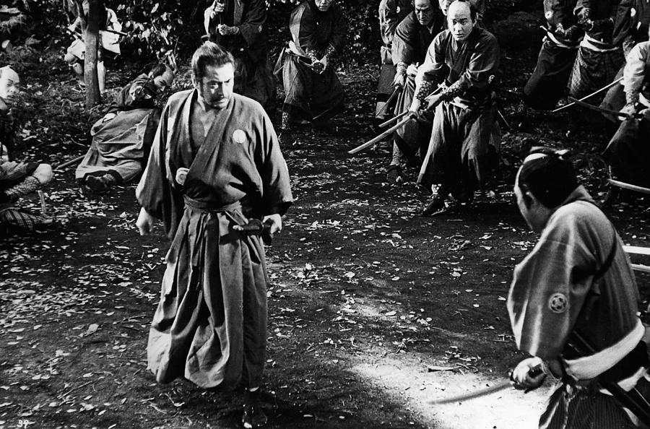
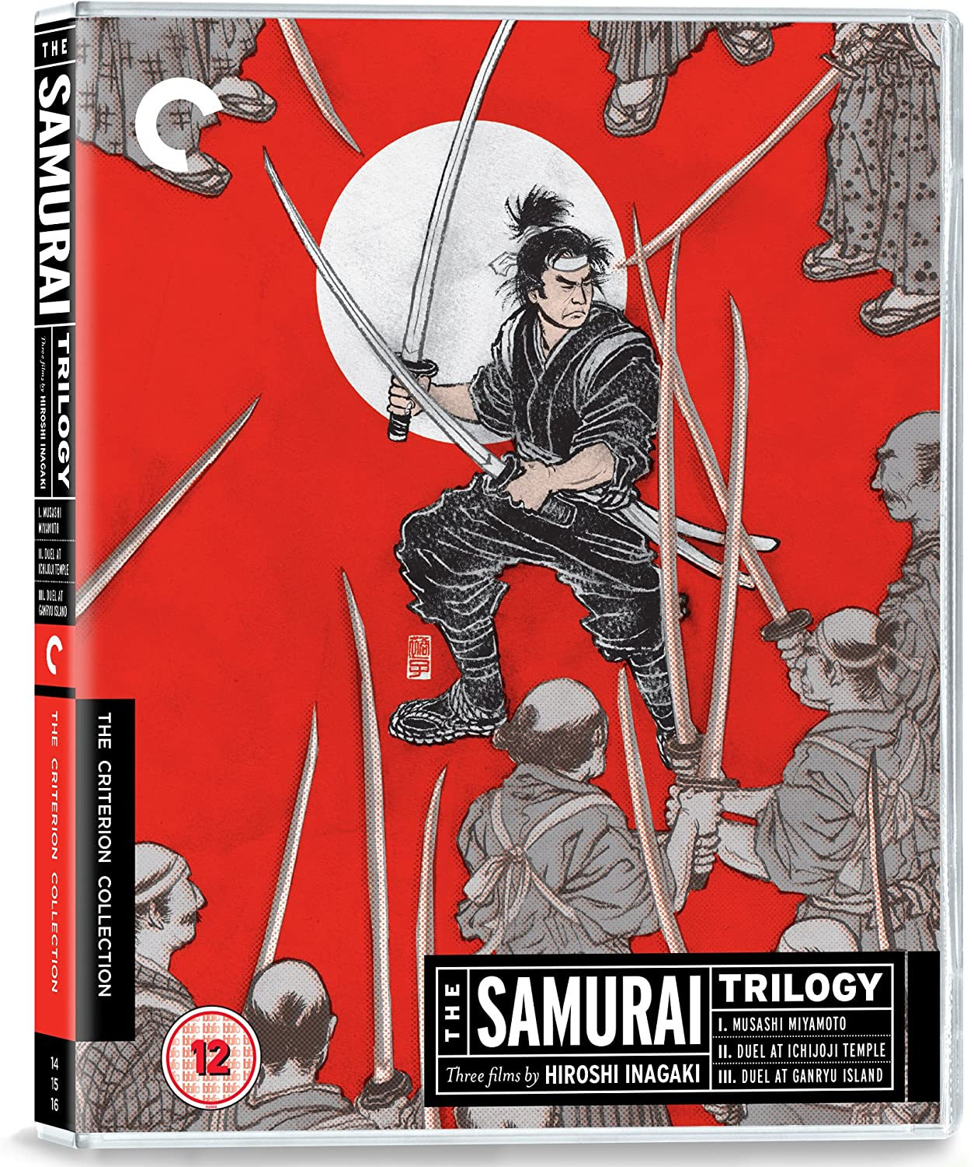
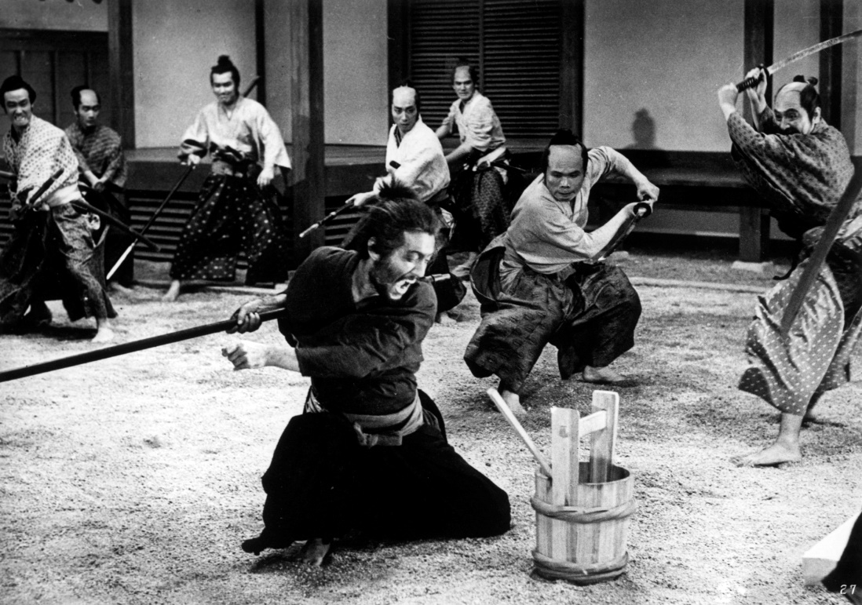
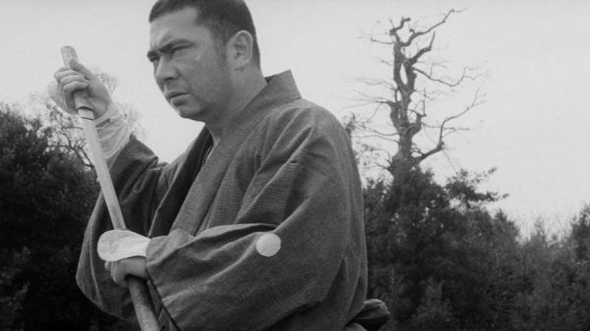
2. Influence of the Bushidō
In many jidageki (period drama) movies, particularly chanbara (“sword play”, i.e. cool sword fights), the theme “good guy protects the weak” is ever-present – often fighting the bad guys at overwhelming odds.
Harakiri (1962)
Sanjuro (1962)
Zatoichi (1962)

Slide 17
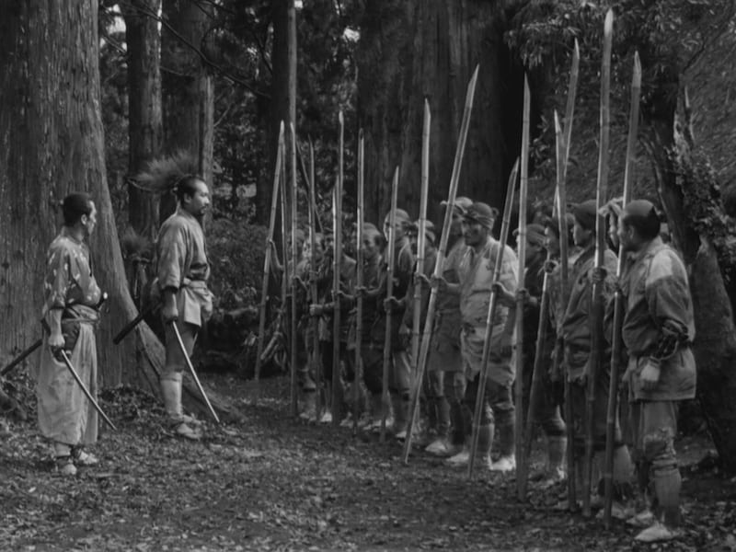
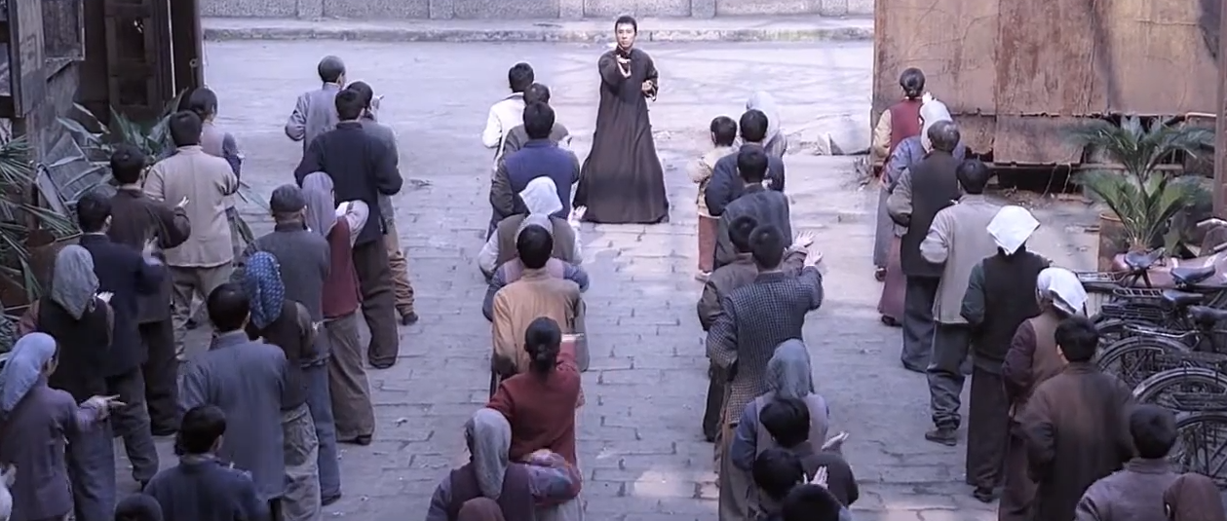
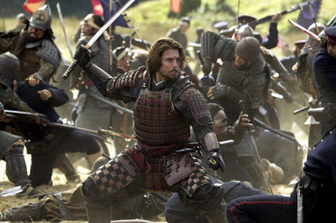
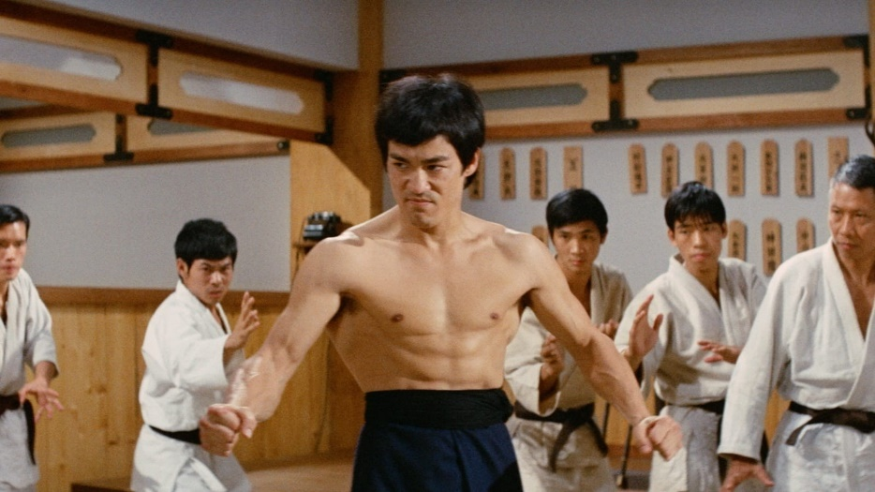
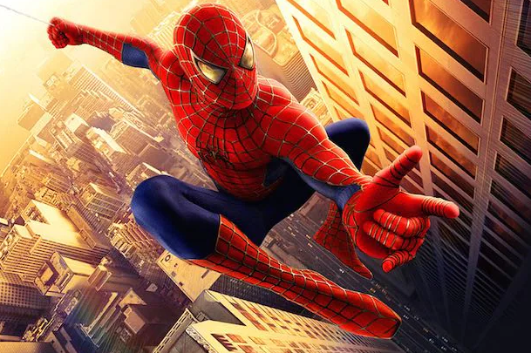
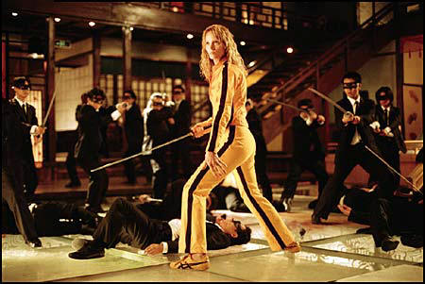
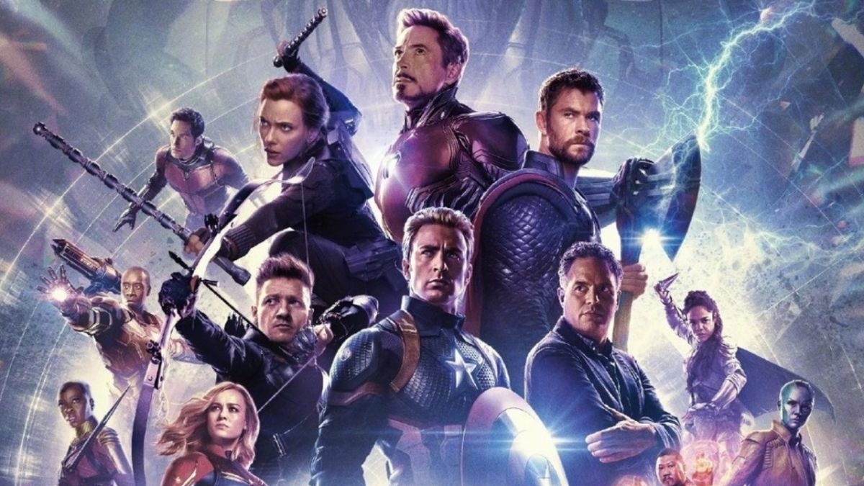
2. Influence of the Bushidō
Seven Samurai (1954)
Ip Man (2008)
Fist of Fury (1972)
The Last Samurai (2003)
Avengers: Endgame (2019)
Spider-Man (2002)
Kill Bill: Volume 1 (2003)

Slide 18
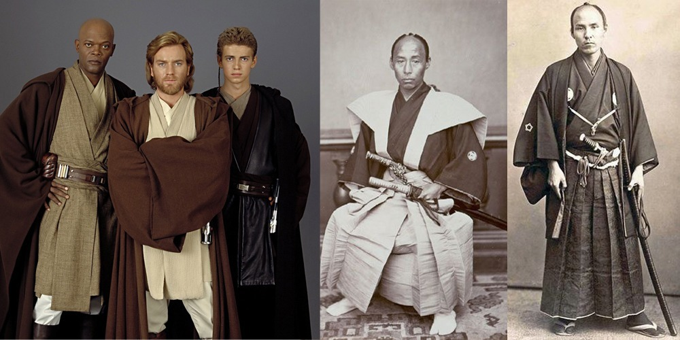
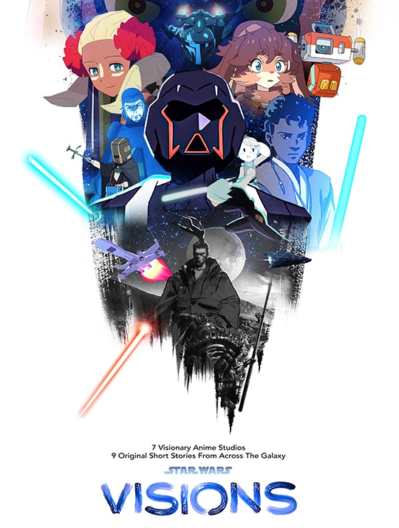
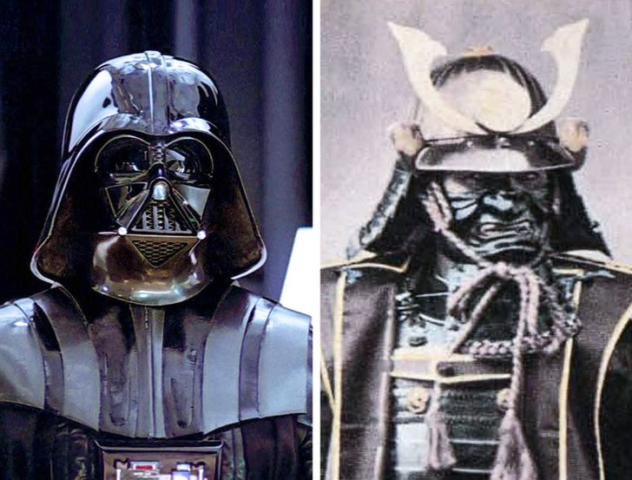
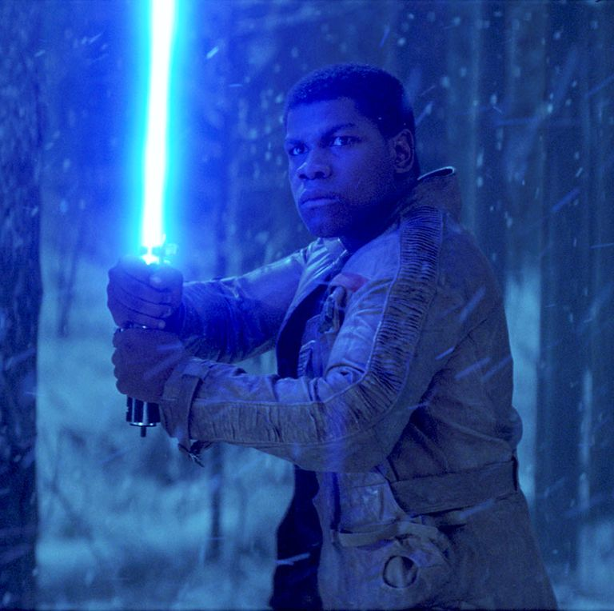
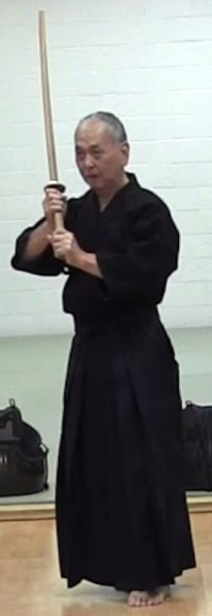
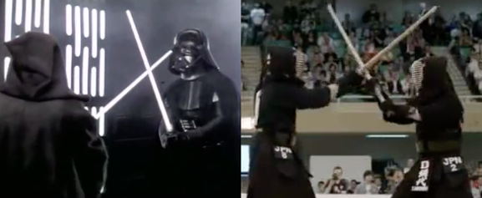
2. Influence of the Bushidō

Slide 19
Lightsaber kendo
https://www.youtube.com/watch?v=3vItyS0Z81w

Slide 20
3. Let’s Watch:
Yojimbo 用心棒 (1961)
Director: Akira Kurosawa

Slide 21
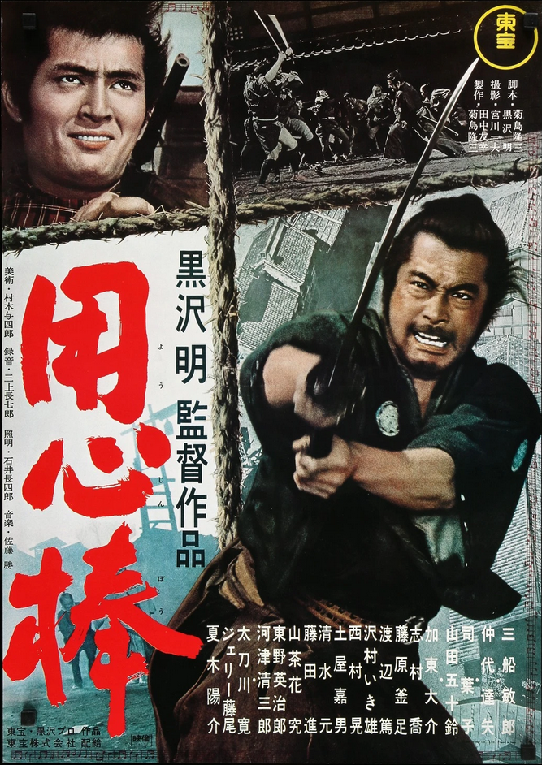
3. Let’s Watch: Yojimbo (1961)
Original story written, and film directed by the famous Akira Kurosawa.
Starring Toshiro Mifune, who is best known for portraying a rōnin in many jidai-geki movies. Widely known for his whole-body movements!
This movie depicts a remote village trapped in the middle of clashes between two rival gangs, whose members continually terrorised the innocent townfolks. Then came our mysterious hero!
Fight scenes here were quiet violent (at the time), and the Director deliberately depicted it this way to portray violence negatively – however had the opposite result of inspiring many other movies glorifying cool sword fights. Oh well.
This movie was later plagiarised (“remade”) by Director Sergio Leone, as A Fistful of Dollars (1964). (They got sued, and lost.)
Later on, Akira Kurosawa admitted that this movie was actually based on the film The Glass Key (1947), which itself is an adaptation of a 1931 novel.

Slide 22
3. Let’s Watch: Yojimbo (1961)
Runtime: 1 hour 50 minutes
Language: Japanese with English subtitles
Yōjinbō 用心棒 means “bodyguard”.
The movie was set in 1860, in the final years of the Edo period (relatively peaceful ~300 years). Japan was under the rule of the Tokugawa shogunate, of which political system delegated the daimyō (ruler) of each han (domain) to autonomously manage their own regions, including law and taxation.
As a result, lower caste peasants suffered from a systemic oppression by anyone with power – through military strength, bureaucratic position, or simply by the sword.
Be on the look out for (what is now) common movie tropes!

Slide 23
3. Let’s Watch: Yojimbo (1961)
Questions / comments?
Enjoy!

