Slide 1
Darwin Kendo Club
Movie Night – Sunday 20 December 2020
Ken (1964)
Bernard Yehuda

Slide 2
Housekeeping
Thank you for coming, whether you are a Kendo practitioner, or as guests – I hope you enjoy the night.
This is not a formal event – feel free to relax, ask questions, laugh, and make fun of each other (especially Angus).
Front door is locked – if you need to exit, please use the side door by the barbecue. Call me (Bernard) if needed – 0430 398 358.
If you need to go to the bathroom, please raise your hands, and keep them up until you return.

Slide 3
Agenda
A Brief History of Sword Arts: From Kenjutsu to Kendo
A Brief Look at Jidaigeki and Chanbara Films
The Narcissism of Yukio Mishima
Let’s Watch: Ken (1964)!

Slide 4
1. A Brief History of Sword Arts:
From Kenjutsu to Kendo

Slide 5
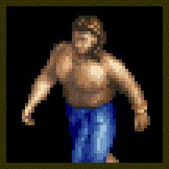
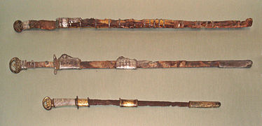
1. A Brief History of Sword Arts: From Kenjutsu to Kendo
Historically, swords were invented around the Bronze Age. According to this guy, that’s between 3000~1200 BC.
Supposedly swords entered Japan around 400 AD, and local production started around in 900 AD.
Katana were not forged until around 1200 AD.
Notes:
Pictured: “The World’s Oldest Surviving Sword”, estimated to be a 5000-year old Anatolian weapon (Eastern Turkey), discovered in the Armenian Monastery of Venice.
https://www.dailymail.co.uk/sciencetech/article-8055409/The-worlds-oldest-weapon-5-000-year-old-Anatolian-sword-discovered-Armenian-Monastery-Venice.html

Slide 6
1. A Brief History of Sword Arts: From Kenjutsu to Kendo
There are different types of Japanese swords / blades (nihon-tō).
Swords used to be straight / double-edged (chokutō / tsurugi).
Then eventually curved (tachi / katana).
Swords can be big (ōdachi / nodachi)…
… or small (kodachi / wakizashi)

Slide 7
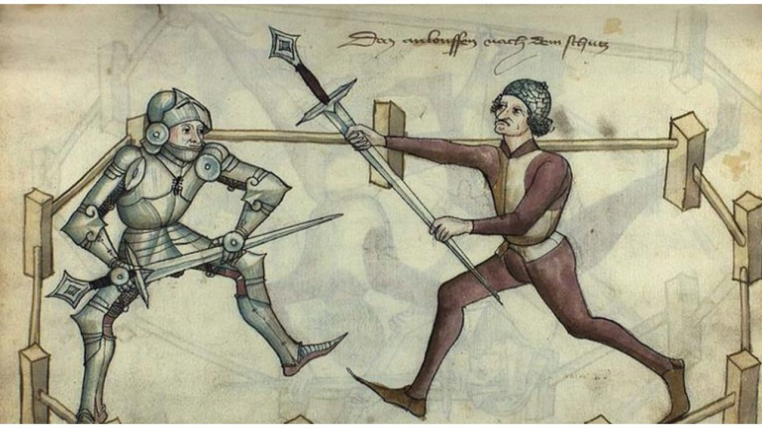
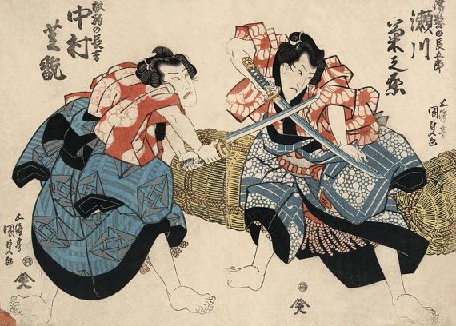
1. A Brief History of Sword Arts: From Kenjutsu to Kendo
The existence of swords = the existence of sword techniques.
Swords were made purely for combat against another human.
In truth, swords were not used much in warfare – the battlefields were ruled by spears and bows.
However, when you have nothing else – you better know how to use one.
Notes:
“Mordhau”, German for “murder strike”, from a 1459 textbook.

Slide 8
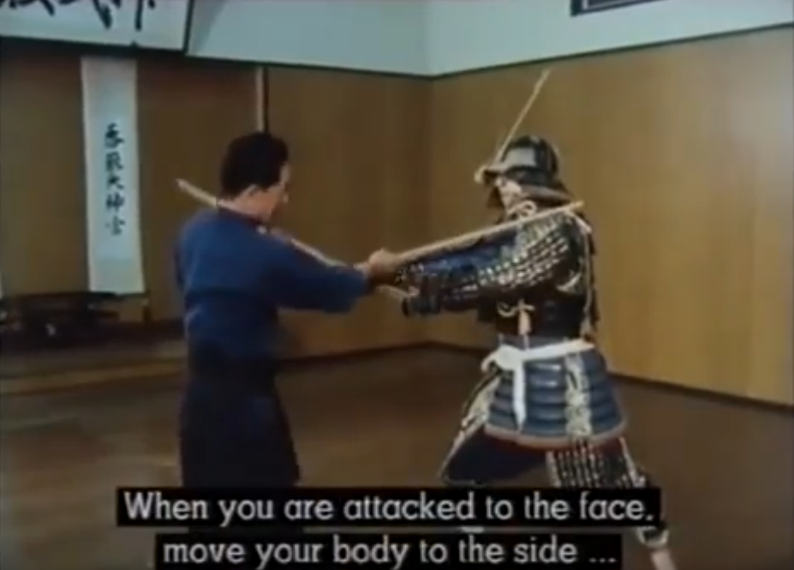
BBC’s The Way of the Warrior - 8. The Samurai Way - Katori Shinto-ryu
https://youtu.be/wBX0qS-DLNE?t=533
08:53 – 12:13
Notes:
BBC’s The Way of the Warrior - 8. The Samurai Way - Katori Shinto-ryu
https://www.youtube.com/watch?v=wBX0qS-DLNE

Slide 9
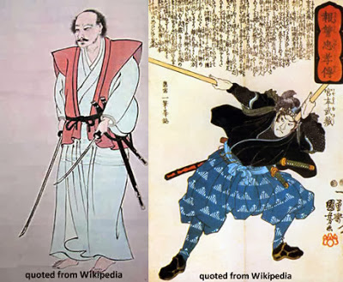
1. A Brief History of Sword Arts: From Kenjutsu to Kendo
Over time, sword arts moved from fighting someone with armour, to fighting without armour. Swords became commonly associated with duels between two people.
Throughout Japanese history, there were hundreds of sword fighting schools (ryu-ha).
Rivalry between schools and styles were very common, resulting in the death of many and survival of a few.
Kenjutsu = “sword technique”
Koryu = “old style” (of swordsmanship)

Slide 10
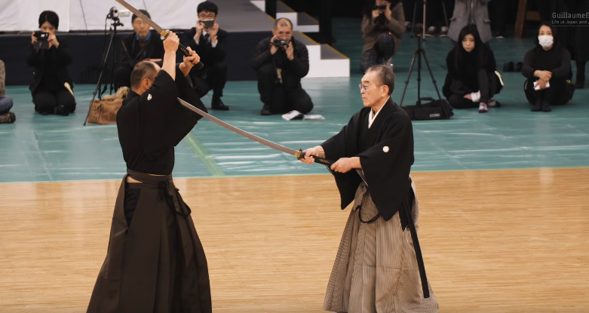
Ono-ha Itto-ryu Kenjutsu - 41st Kobudo Demonstration 2018
https://youtu.be/ndkh8MQw9ZM?t=405
06:45 – 07:27
Notes:
Ono-ha Itto-ryu Kenjutsu - 41st Kobudo Demonstration 2018
https://www.youtube.com/watch?v=ndkh8MQw9ZM

Slide 11
1. A Brief History of Sword Arts: From Kenjutsu to Kendo
Due to industrialisation (Meiji Restoration era) and World War, martial arts became a relic of the past.
Many schools and arts were lost, and it wasn’t until the foundation of organisations focusing on cultural and heritage preservation – such as the Dai Nippon Butokukai – that modern versions of martial arts were developed.
Due to the gap between traditional and modern arts, this often results in the older arts being heavily romanticised in films.
One example is “dojo-yaburi”, which has become a common theme amongst martial art movies – going into someone’s dojo to beat everyone up, to either take over the school, or simply for fame.

Slide 12
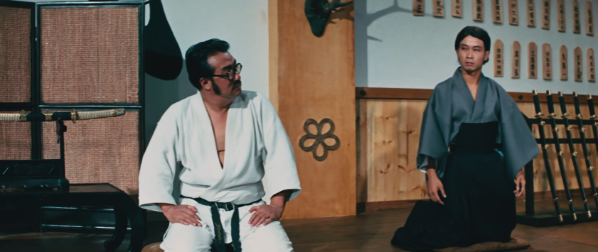
Fist of Fury (1972) – starring Bruce Lee as Chen Zen
https://youtu.be/MigKXB_zSyo?t=90
01:30 – 02:07
Notes:
Fist of Fury (1972) – starring Bruce Lee as Chen Zen
https://www.youtube.com/watch?v=MigKXB_zSyo

Slide 13
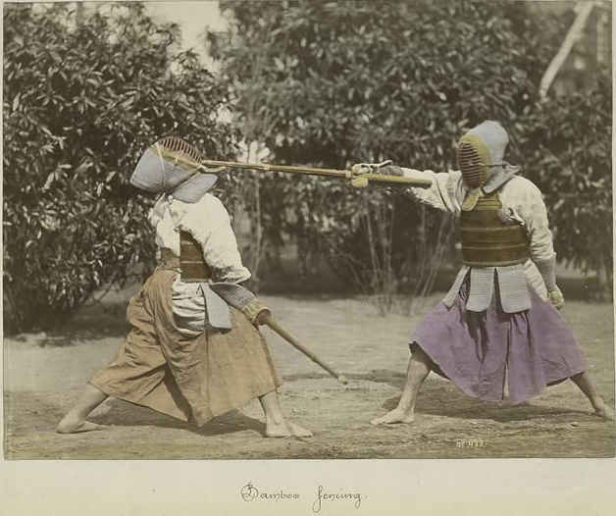
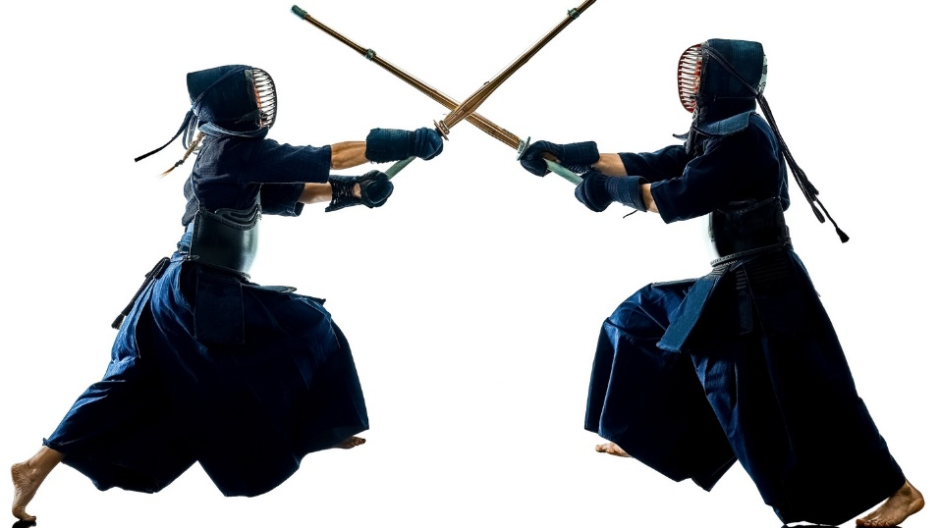
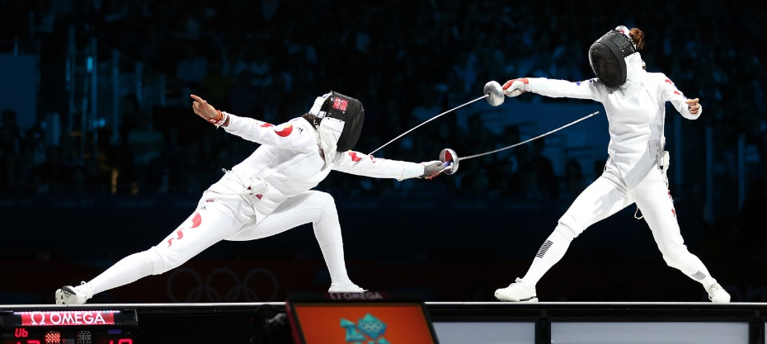
1. A Brief History of Sword Arts: From Kenjutsu to Kendo
Today, we have modern versions of sword fighting techniques.
Both Fencing and Kendo were designed to be a sport, based on martial arts – seeing little practical value on actual fighting.
However, the value is in focusing on the “dō” part – as a way of life, a method of learning discipline, self control, etc.
And also fun!

Slide 14
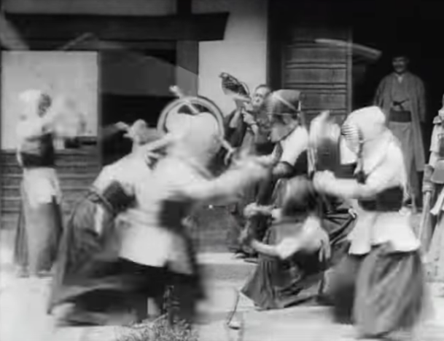
The first kendo motion picture - from 1897
https://youtu.be/WN9SDF05nX0?t=35
0:35 - 1:17
Notes:
The first kendo motion picture - from 1897
https://www.youtube.com/watch?v=WN9SDF05nX0

Slide 15
2. A Brief Look at
Jidaigeki and Chanbara Films

Slide 16
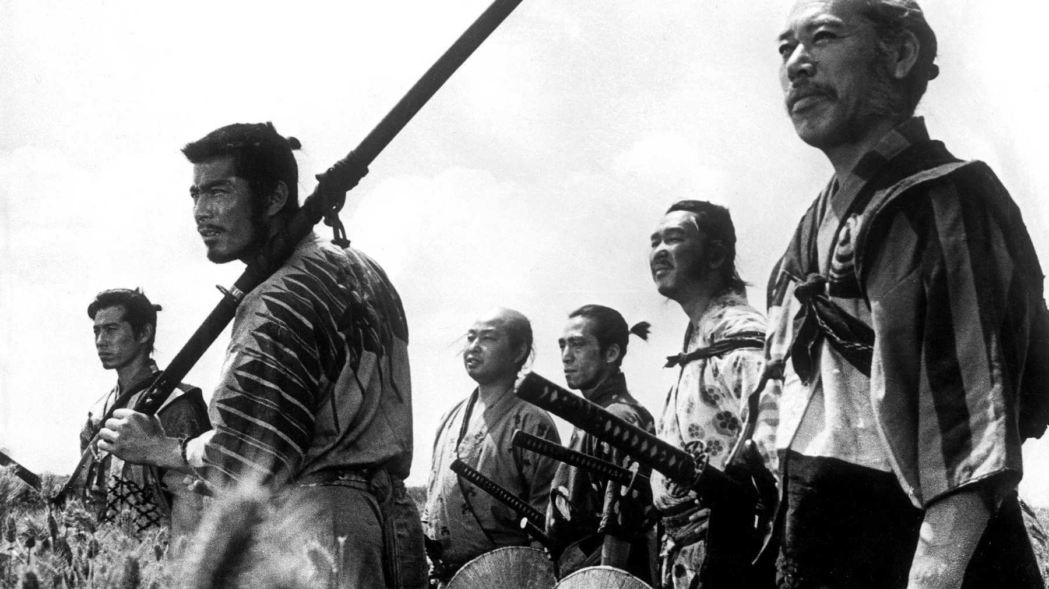
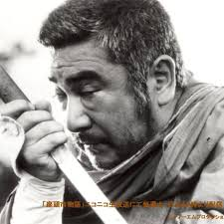
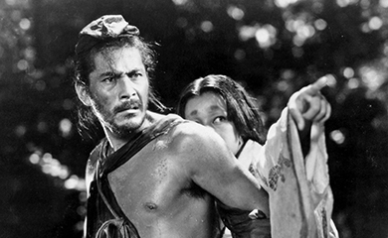
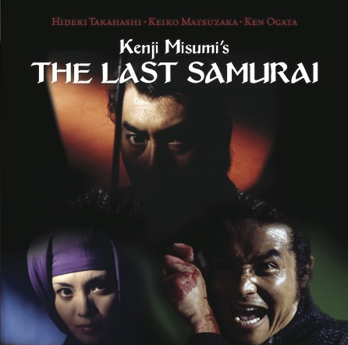
2. A Brief Look at Jidaigeki and Chanbara Films
Jidageki = period drama – a genre of films usually set in the Edo period / Tokugawa era of Japanese history – between 1600~1800s.
The more popular ones with sword fighting are often referred to as chanbara – “sword fight”.
Most stories depict conflicts between politicians, samurai, and the effects of war and oppression on common people.

Slide 17
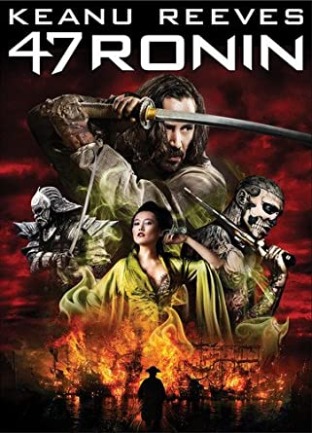
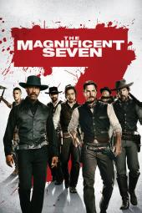
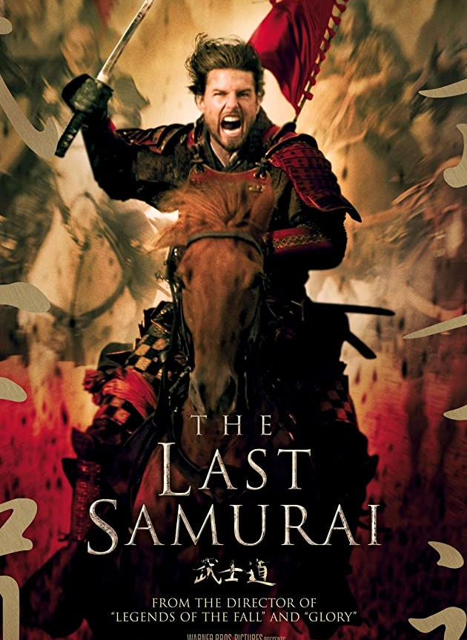
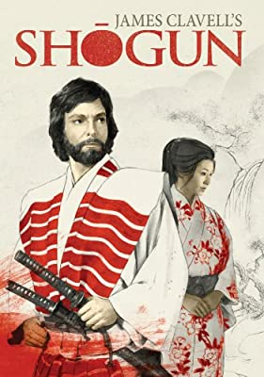
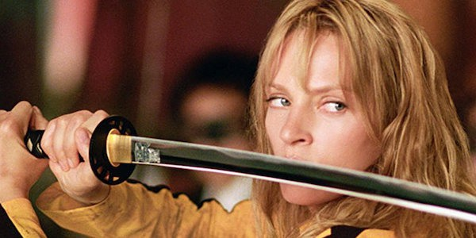
2. A Brief Look at Jidaigeki and Chanbara Films
Many of these jidaigeki films came out in the 1960s, when TVs and cinemas were still black & white.
Despite their age, these have had considerable influence in Hollywood – many movies were either heavily inspired, or a remake.

Slide 18
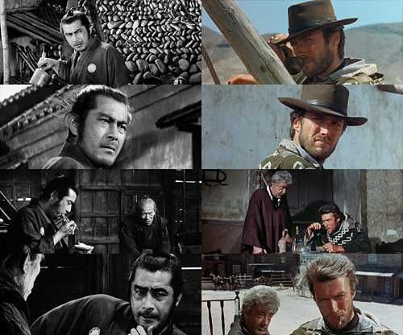
2. A Brief Look at Jidaigeki and Chanbara Films
Probably the famous “duo” were the Director Akira Kurosawa and actor Toshiro Mifune.
Their work directly influenced, or were straight plagiarised, many famous films:
Star Wars (The Hidden Fortress)
A Fistful of Dollars (Yojimbo)
Kill Bill (Sanjuro)
The Mandalorian (Lone Wolf and Cub)

Slide 19
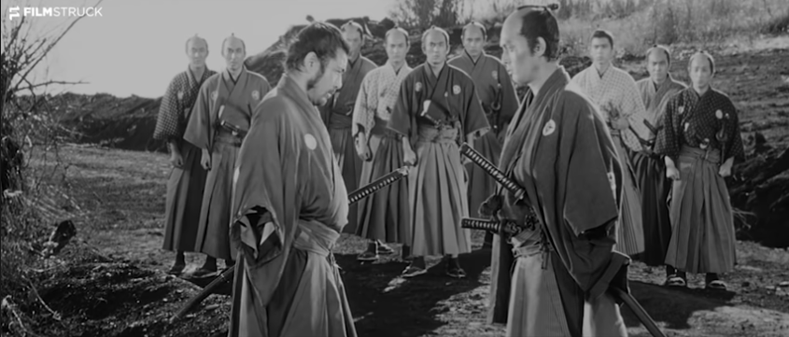
Akira Kurosawa’s Sanjuro (1962)
https://www.youtube.com/watch?v=SfpagB8wWng
0:00 - 1:49
Notes:
Akira Kurosawa’s Sanjuro (1962)
https://www.youtube.com/watch?v=SfpagB8wWng

Slide 20
3. The Narcissism of
Yukio Mishima

Slide 21
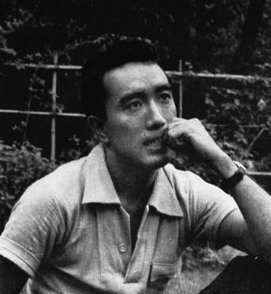
3. The Narcissism of Yukio Mishima
Japanese author, poet, playwright, actor, model, Shintoist, nationalist.
Received many awards, was considered for a Nobel Prize in Literature in 1968.
“Mishima's work is characterized by ‘its luxurious vocabulary and decadent metaphors, its fusion of traditional Japanese and modern Western literary styles, and its obsessive assertions of the unity of beauty, eroticism and death’.”

Slide 22
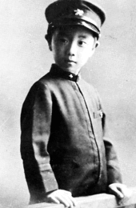
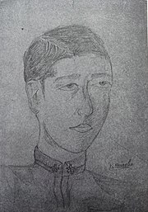
3. The Narcissism of Yukio Mishima
Born in 1925 as Kimitake Hiraoka, raised by grandparents. Became obsessed with many forms of traditional Japanese performance arts – such as Kabuki and Noh.
In high school, was heavily invested in literature and classical poetry. Praised as a “genius” and “heaven-sent”, adopted the pen name Yukio Mishima as his fame started to grow.

Slide 23
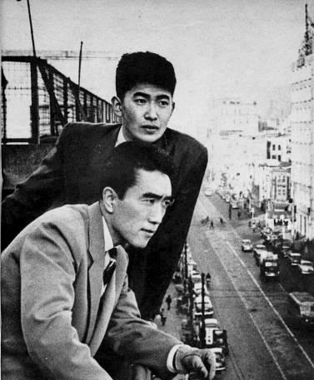
3. The Narcissism of Yukio Mishima
In 1944, received a draft notice for the Imperial Japanese Army. Barely passed examination, although his cold was misdiagnosed with tuberculosis, declaring him unfit for service.
In 1945, younger sister died from typhoid fever.
Around the same time, he found out that the girl he totally had a crush on just got engaged with another man.
Eventually developed an inferiority complex about his frail constitution, which later made him obsessed with physical fitness and body building.

Slide 24
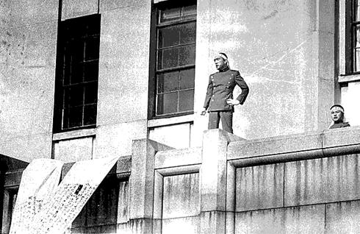
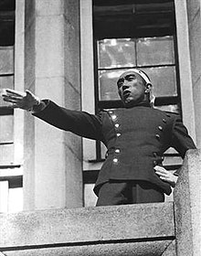
3. The Narcissism of Yukio Mishima
In October 1968, founded the Tatenokai (“Shield Society”) – an unarmed civilian militia with the purpose of “restoring sacredness and dignity to the Japanese Emperor”.
On 25 November 1970, Yukio and four members of the Tatenokai entered one of the headquarters of the Japan Self-Defense Forces, and barricaded themselves inside one of the buildings.
Holding the commandant as hostage, he attempted a coup, and delivered a speech on the balcony.
He then committed seppuku – ritual suicide.

Slide 25
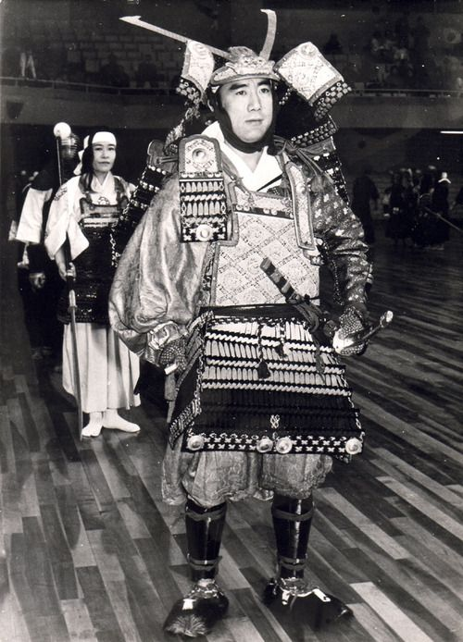
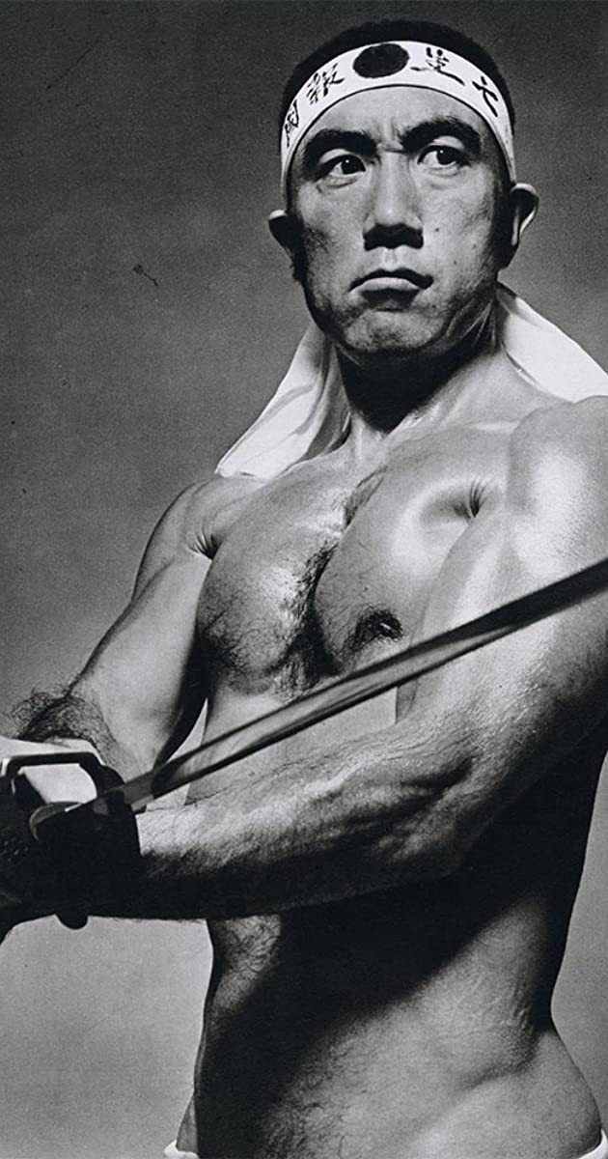
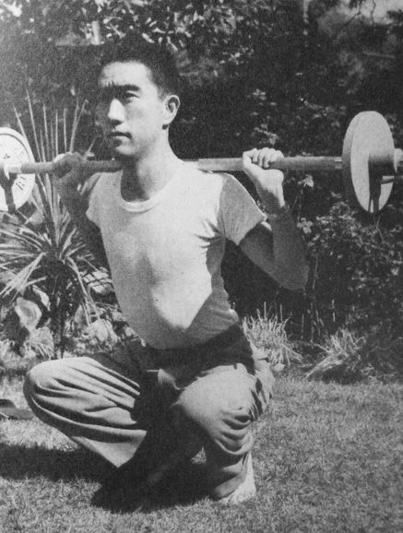
3. The Narcissism of Yukio Mishima
“Fake it ‘till you make it” – he made it, but never stopped faking it.
Claimed to be a Kendo practitioner – was in fact part of the Japanese team in the 1st World Kendo Championships in 1970 (likely as part of a goodwill match).
There’s a video of him doing Iaido kata Ipponme – very poorly.
Obsessed with looking like the biggest chad – he was the proto weeaboo.

Slide 26
4. Let’s Watch:
Ken (1964)

Slide 27
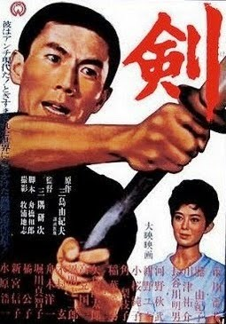
4. Let’s Watch: Ken (1964)
Originally a short story by Yukio Mishima.
Directed by Kenji Misumi, known for many jidaigeki / chanbara films, such as Lone Wolf and Cub, the first few Zatoichi films.
Ken was the only movie he directed of which story was set in the modern era.
The story is about a university student called Kokubu Jiro, and his struggle with leading the other members of the Kendo club.

Slide 28
4. Let’s Watch: Ken (1964)
Runtime: 1 hour 37 minutes
Language: Japanese with English subtitle
While the movie is quite serious and dry, please watch it with consideration of the author and the message he was trying to portray.
By today’s standard, this movie looks like a parody or satire. Except that they were actually serious. (But please feel free to laugh.)
I hope you don’t mind if I provide a few commentaries along the way.

Slide 29
4. Let’s Watch: Ken (1964)
Questions / comments?
Enjoy!

